Slide 1






Ice Cream Machine Simulation
Concurrent Programming with POSIX Threads

Slide 2
Presented By:
Name: Tahira Tasnim
ID: 2023-3-60-267
Name: Nurtaz Reza
ID: 2023-3-60-282
Presenting To:
Shatabdi Roy Moon
Lecturer,
Department of Computer Science & Engineering.

Slide 3




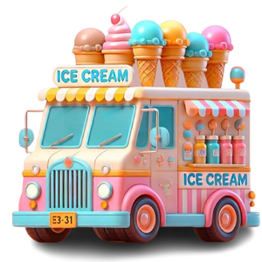
Problem Statement
Busy cafeteria self-service ice cream machine......
Multiple customers arrive simultaneously.
Limited number of cones → refill required.
Limited flavor slots → at most 2 at a time.
Need safe coordination to avoid race/chaos.

Slide 4

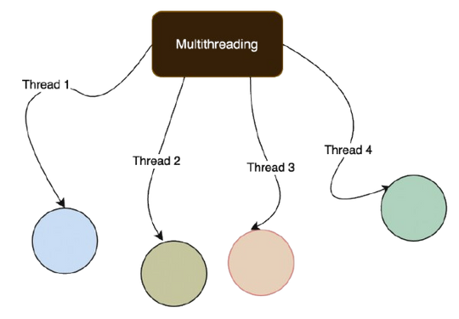
Project Objectives
Simulate real-world concurrency problem.
Implement with threads, mutex, semaphore, cond var.
Ensure safe shared resource access.
Collect statistics: served count, refills, avg wait time.

Slide 5
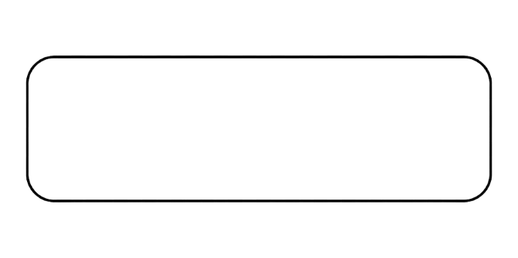
System Overview
Customers: 15 threads, try to take cones.
Refill Bot: Automatic cone restocking.
Shared resources: Cone inventory (max 10) , Flavor dispensers (2 slots), Statistics tracking.
Main program: Spawns threads, joins, shows summary.
Ice Cream
Machine
───►
Refill Bot (thread) { Cones + Flavor Slots }
Customers (threads) ──►
──►
Served Ice Cream

Slide 6
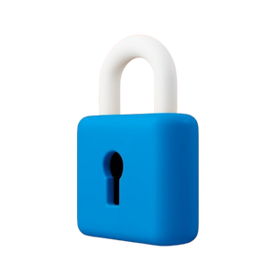
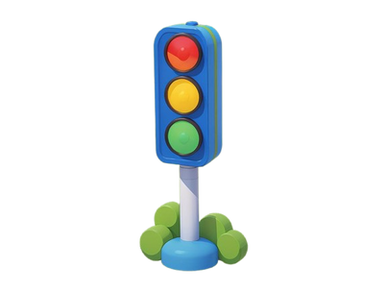
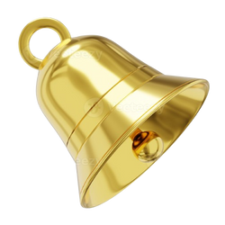
Synchronization Mechanisms
Synchronization Tools Used:
Mutexes (3):
cone_mutex → Cone availability protection
stats_mutex → Statistics safety
output_mutex → Thread-safe printing
Semaphore (1):
flavor_sem → Limits concurrent dispensing (2 slots)
Condition Variable (1):
refill_cond → Refill coordination

Slide 7

Customer Thread Workflow
Step-by-Step Process:
  Arrival: Random timing, get customer ID.
2. Cone Request: Wait if unavailable, trigger refill.
3. Wait Time Measurement: Track performance metrics.
4. Flavor Selection: Wait for dispenser slot (semaphore).
5. Dispensing: Simulate service time (1-3 seconds).
6. Completion: Update statistics, free resources.
Arrive
🚶‍♂️
Cone
🍦
Wait
⏳
Refill
Bot
🤖
Exit
✅
Dispense
🎉

Slide 8
Refill Bot Algorithm
Refill Bot Logic:
  Passive Waiting: Sleeps until refill needed.
2. Signal Detection: Customers signal when cones empty.
3. Smart Refilling: Adds REFILL_AMOUNT (10) but caps at MAX_CONES.
4. Customer Notification: Broadcasts to wake waiting customers.
5. Graceful Exit: Terminates when simulation ends.
🍦 MACHINE STATE - BEFORE REFILL
🍦 MACHINE STATE - AFTER REFILL
Available Cones: 0 ❌
Waiting Customers: 3 😫
Active Dispensers: 0
Refill Bot: SLEEPING 😴
Available Cones: 10 ✅
Waiting Customers: 0
Active Dispensers: 2
Refill Bot: SLEEPING 😴
Customer Queue: 🚶‍♂️🚶‍♀️🚶‍♂️ (all blocked)
Customer Activity: 😊🍦 🚶‍♂️ (serving + new arrival)

Slide 9
Code Structure & Key Functions
Major Functions:
customer_thread() → Individual customer behavior
refill_bot() → Automatic restocking logic
wait_for_cone() → Cone allocation with waiting
safe_print() → Thread-safe output
init_machine() → System initialization
Code Quality Features:
  Error checking on all “pthread” operations.
  Clean resource cleanup.
  Thread-local random number generation.
  Proper memory management.

Slide 10
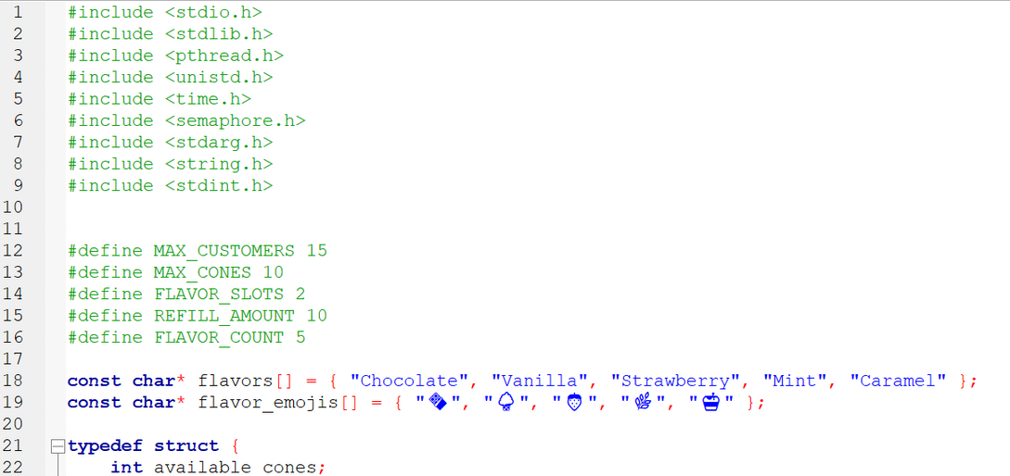
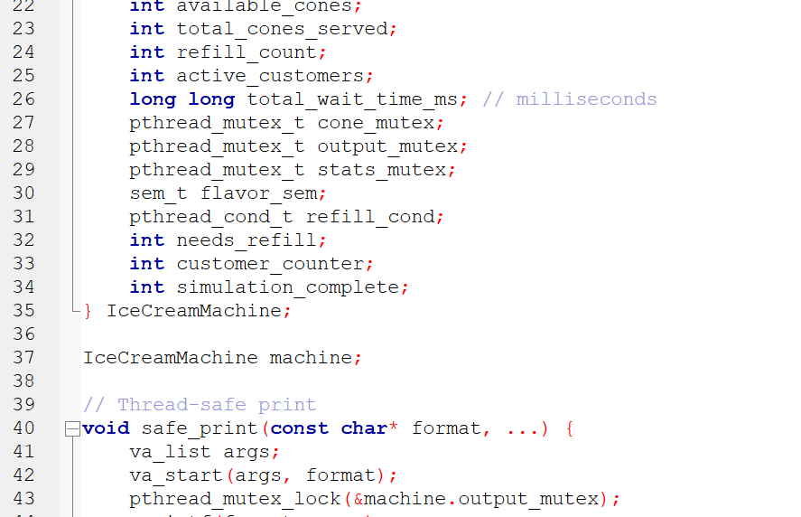
Code:
1
2

Slide 11
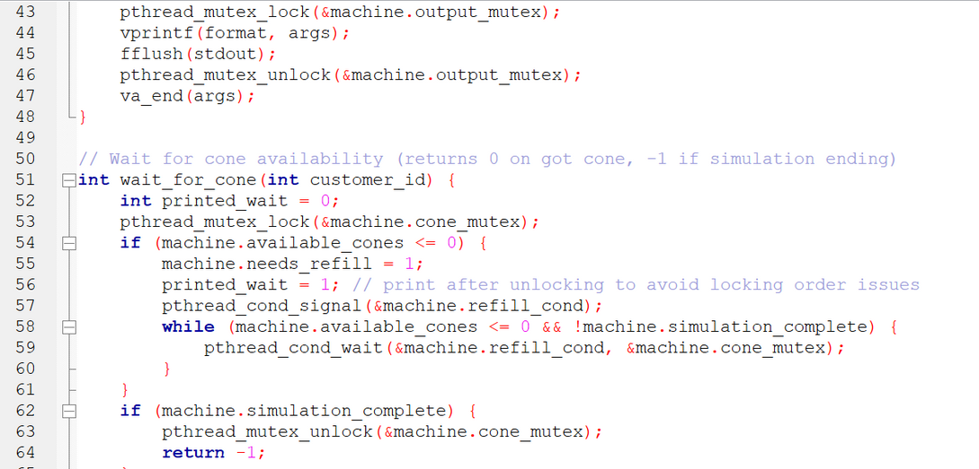
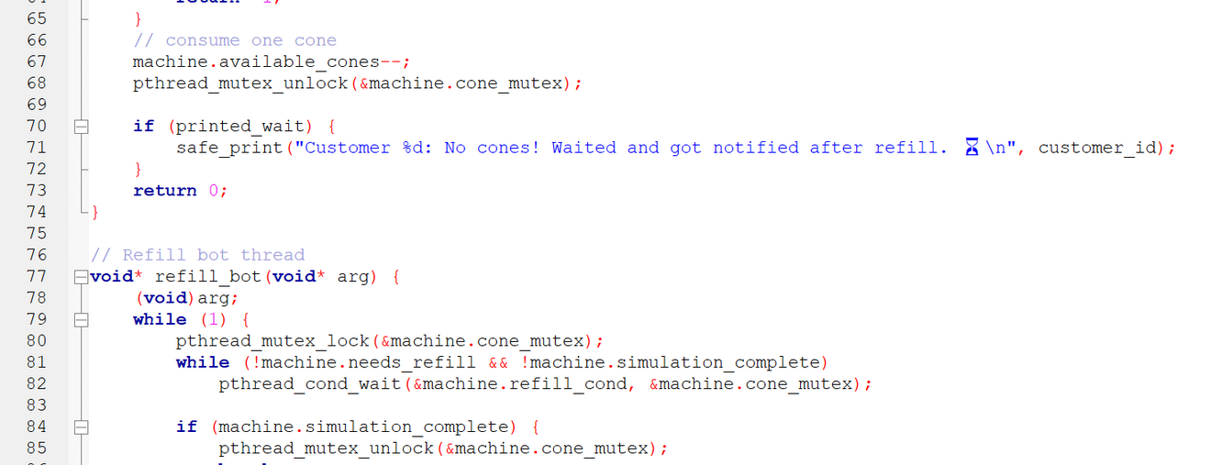
Code:
3
4

Slide 12
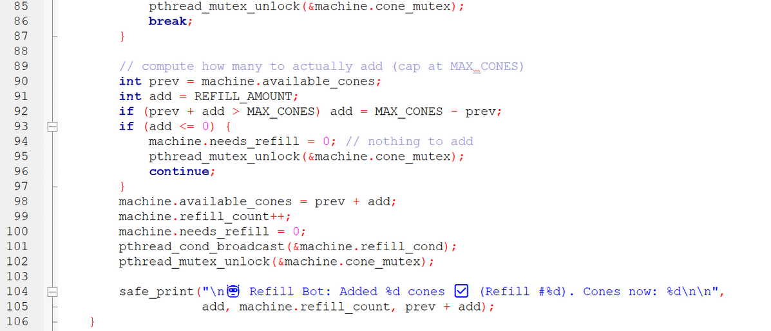
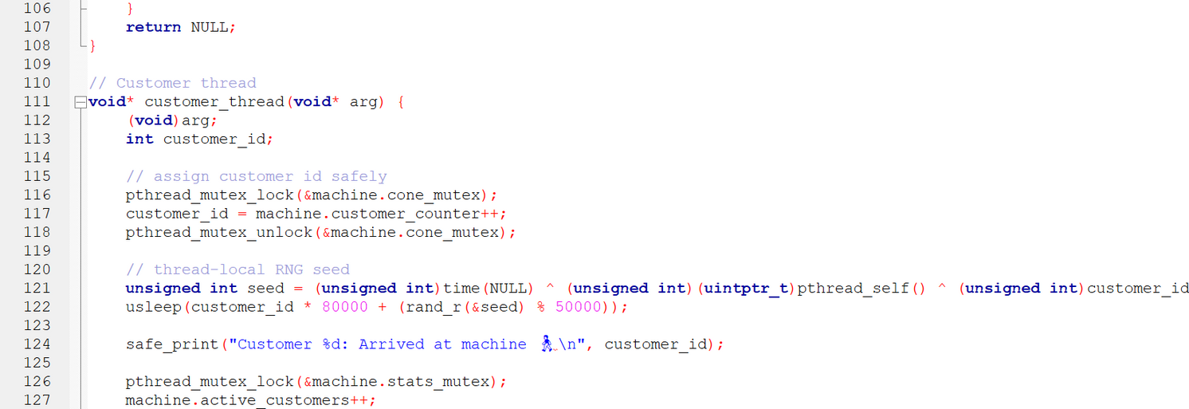
Code:
5
6

Slide 13
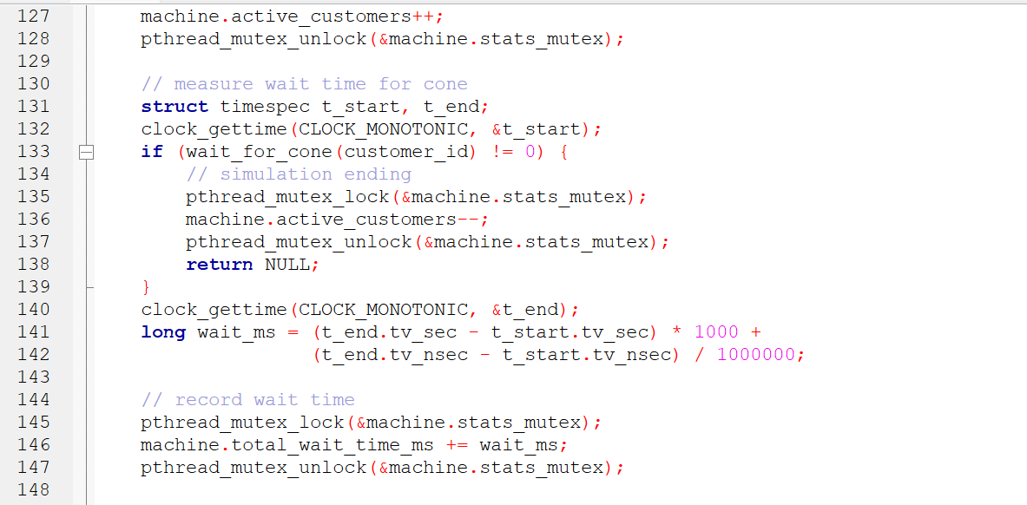
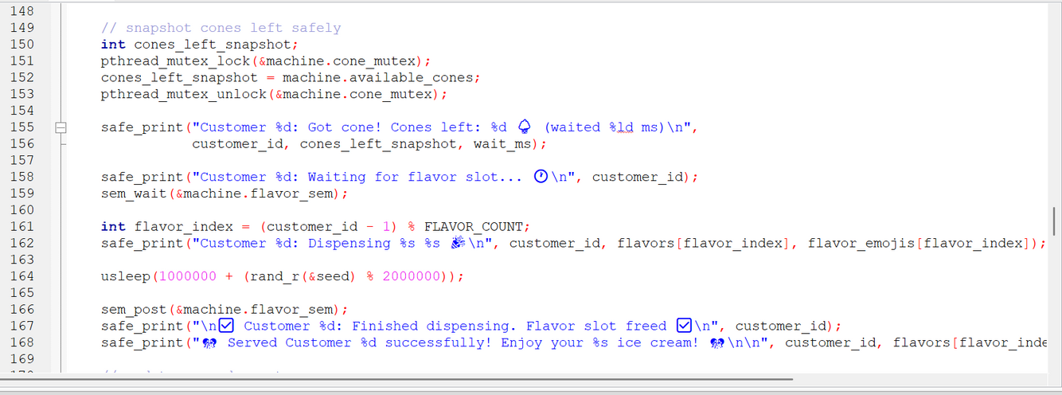
Code:
7
8

Slide 14
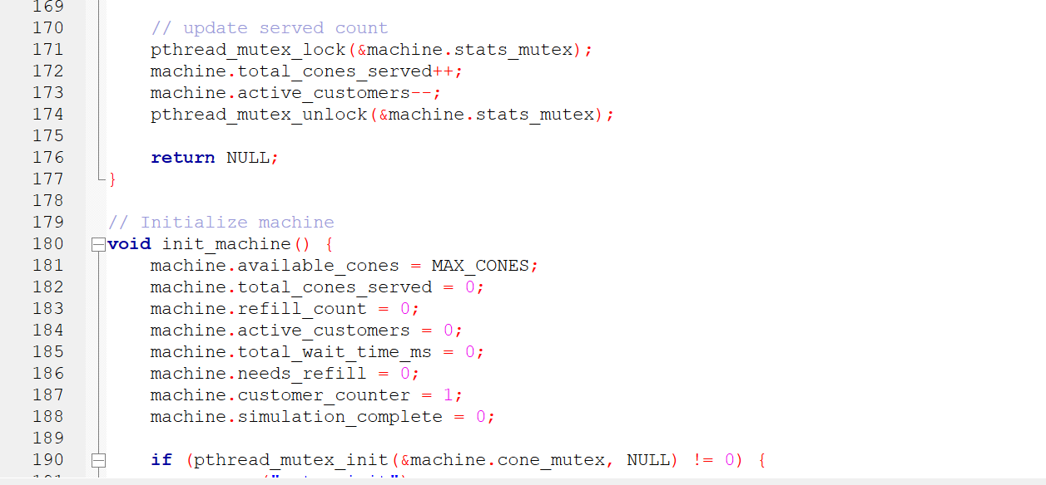
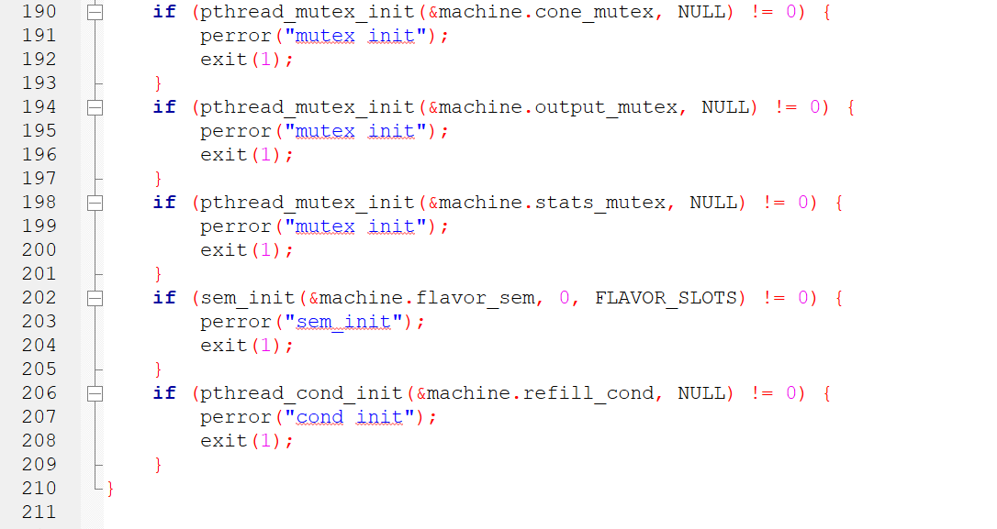
Code:
9
10

Slide 15
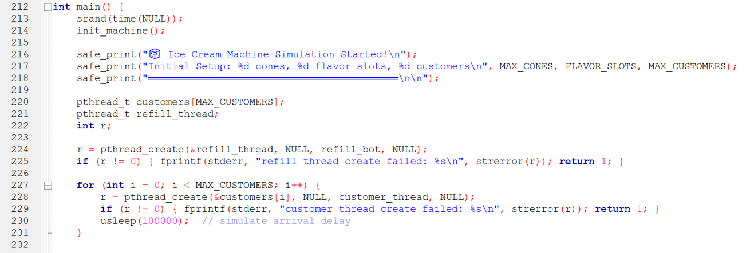
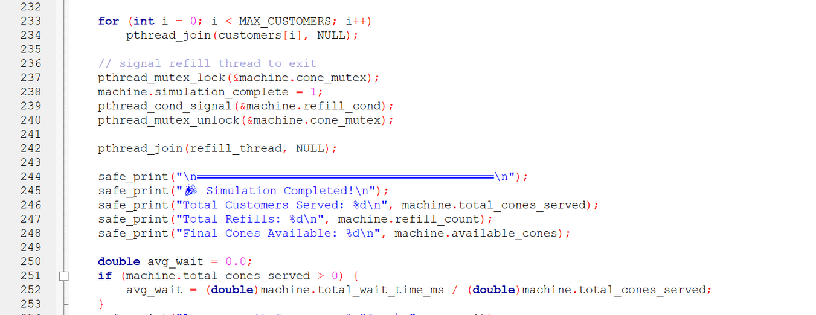
Code:
11
12

Slide 16
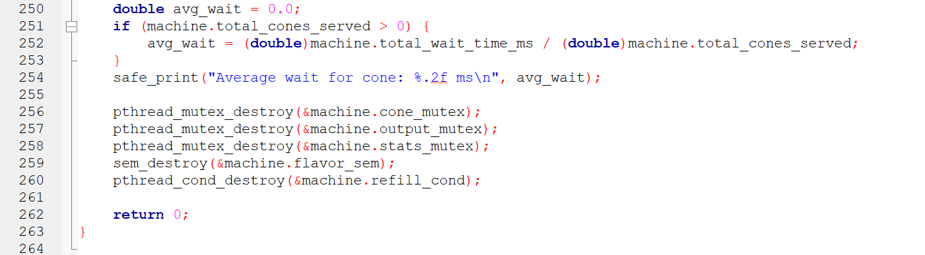
Code:
13

Slide 17
Output:
🧊 Ice Cream Machine Simulation Started!
Initial Setup: 10 cones, 2 flavor slots, 15 customers
══════════════════════════════════════════
Customer 1: Arrived at machine 🚶‍♂️
Customer 1: Got cone! Cones left: 9 🍦 (waited 0 ms)
Customer 1: Waiting for flavor slot... 🕐
Customer 1: Dispensing Chocolate 🍫 🎉
Customer 2: Arrived at machine 🚶‍♂️
Customer 2: Got cone! Cones left: 8 🍦 (waited 0 ms)
Customer 2: Waiting for flavor slot... 🕐
Customer 2: Dispensing Vanilla 🍦 🎉
Customer 3: Arrived at machine 🚶‍♂️
Customer 3: Got cone! Cones left: 7 🍦 (waited 0 ms)
Customer 3: Waiting for flavor slot... 🕐
Customer 4: Arrived at machine 🚶‍♂️
Customer 4: Got cone! Cones left: 6 🍦 (waited 0 ms)
Customer 4: Waiting for flavor slot... 🕐
Customer 5: Arrived at machine 🚶‍♂️
Customer 5: Got cone! Cones left: 5 🍦 (waited 0 ms)

Slide 18
Output:
Customer 5: Waiting for flavor slot... 🕐
Customer 6: Arrived at machine 🚶‍♂️
Customer 6: Got cone! Cones left: 4 🍦 (waited 0 ms)
Customer 6: Waiting for flavor slot... 🕐
Customer 7: Arrived at machine 🚶‍♂️
Customer 7: Got cone! Cones left: 3 🍦 (waited 0 ms)
Customer 7: Waiting for flavor slot... 🕐
Customer 8: Arrived at machine 🚶‍♂️
Customer 8: Got cone! Cones left: 2 🍦 (waited 0 ms)
Customer 8: Waiting for flavor slot... 🕐
Customer 9: Arrived at machine 🚶‍♂️
Customer 9: Got cone! Cones left: 1 🍦 (waited 0 ms)
Customer 9: Waiting for flavor slot... 🕐
Customer 10: Arrived at machine 🚶‍♂️
Customer 10: Got cone! Cones left: 0 🍦 (waited 0 ms)
Customer 10: Waiting for flavor slot... 🕐
Customer 11: Arrived at machine 🚶‍♂️
🤖 Refill Bot: Added 10 cones ✅ (Refill #1). Cones now: 10
Customer 11: No cones! Waited and got notified after refill. ⏳
Customer 11: Got cone! Cones left: 9 🍦 (waited 0 ms)
Customer 11: Waiting for flavor slot... 🕐

Slide 19
Output:
Customer 12: Arrived at machine 🚶‍♂️
Customer 12: Got cone! Cones left: 8 🍦 (waited 0 ms)
Customer 12: Waiting for flavor slot... 🕐
Customer 13: Arrived at machine 🚶‍♂️
Customer 13: Got cone! Cones left: 7 🍦 (waited 0 ms)
Customer 13: Waiting for flavor slot... 🕐
Customer 14: Arrived at machine 🚶‍♂️
Customer 14: Got cone! Cones left: 6 🍦 (waited 0 ms)
Customer 14: Waiting for flavor slot... 🕐
✅ Customer 1: Finished dispensing. Flavor slot freed ✅
🎊 Served Customer 1 successfully! Enjoy your Chocolate ice cream! 🎊
Customer 3: Dispensing Strawberry 🍓 🎉
Customer 15: Arrived at machine 🚶‍♂️
Customer 15: Got cone! Cones left: 5 🍦 (waited 0 ms)
Customer 15: Waiting for flavor slot... 🕐
✅ Customer 2: Finished dispensing. Flavor slot freed ✅
🎊 Served Customer 2 successfully! Enjoy your Vanilla ice cream! 🎊
Customer 4: Dispensing Mint 🌿 🎉

Slide 20
Output:
✅ Customer 3: Finished dispensing. Flavor slot freed ✅
🎊 Served Customer 3 successfully! Enjoy your Strawberry ice cream! 🎊
Customer 5: Dispensing Caramel 🍯 🎉
✅ Customer 4: Finished dispensing. Flavor slot freed ✅
🎊 Served Customer 4 successfully! Enjoy your Mint ice cream! 🎊
Customer 6: Dispensing Chocolate 🍫 🎉
✅ Customer 5: Finished dispensing. Flavor slot freed ✅
🎊 Served Customer 5 successfully! Enjoy your Caramel ice cream! 🎊
Customer 7: Dispensing Vanilla 🍦 🎉
✅ Customer 6: Finished dispensing. Flavor slot freed ✅
🎊 Served Customer 6 successfully! Enjoy your Chocolate ice cream! 🎊
Customer 8: Dispensing Strawberry 🍓 🎉
✅ Customer 8: Finished dispensing. Flavor slot freed ✅
🎊 Served Customer 8 successfully! Enjoy your Strawberry ice cream! 🎊

Slide 21
Output:
Customer 9: Dispensing Mint 🌿 🎉
✅ Customer 7: Finished dispensing. Flavor slot freed ✅
🎊 Served Customer 7 successfully! Enjoy your Vanilla ice cream! 🎊
Customer 10: Dispensing Caramel 🍯 🎉
✅ Customer 9: Finished dispensing. Flavor slot freed ✅
🎊 Served Customer 9 successfully! Enjoy your Mint ice cream! 🎊
Customer 11: Dispensing Chocolate 🍫 🎉
✅ Customer 10: Finished dispensing. Flavor slot freed ✅
🎊 Served Customer 10 successfully! Enjoy your Caramel ice cream! 🎊
Customer 12: Dispensing Vanilla 🍦 🎉
✅ Customer 11: Finished dispensing. Flavor slot freed ✅
🎊 Served Customer 11 successfully! Enjoy your Chocolate ice cream! 🎊
Customer 13: Dispensing Strawberry 🍓 🎉
✅ Customer 12: Finished dispensing. Flavor slot freed ✅
🎊 Served Customer 12 successfully! Enjoy your Vanilla ice cream! 🎊

Slide 22
Output:
Customer 14: Dispensing Mint 🌿 🎉
✅ Customer 14: Finished dispensing. Flavor slot freed ✅
🎊 Served Customer 14 successfully! Enjoy your Mint ice cream! 🎊
Customer 15: Dispensing Caramel 🍯 🎉
✅ Customer 13: Finished dispensing. Flavor slot freed ✅
🎊 Served Customer 13 successfully! Enjoy your Strawberry ice cream! 🎊
✅ Customer 15: Finished dispensing. Flavor slot freed ✅
🎊 Served Customer 15 successfully! Enjoy your Caramel ice cream! 🎊
══════════════════════════════════════════
🎉 Simulation Completed!
Total Customers Served: 15
Total Refills: 1
Final Cones Available: 5
Average wait for cone: 0.00 ms
=== Code Execution Successful ===

Slide 23
Technical Achievements
Concurrency Solutions:
  Race Condition Prevention: All shared data protected.
2. Deadlock Avoidance: Consistent lock ordering
3. Resource Fairness: Semaphore-based fair access.
4. Performance Tracking: Real-time statistics collection
Advanced Features:
  Thread-safe randomization with rand_r().
  Millisecond-precision wait time measurement.
  Automatic refill with capacity management.
  Clean simulation termination.

Slide 24
Learning Outcomes & Conclusion
Skills Demonstrated:
pthread Management: Creation, joining, synchronization
Mutex Usage: Protecting critical sections
Semaphore Implementation: Resource counting
Condition Variables: Thread coordination
Statistics Collection: Performance measurement
Real-world Applications:
  Server request handling
  Database connection pooling
  Resource management systems
  Producer-consumer scenarios

Slide 25
Thank You
Questions? Let’s scoop into them!

